Slide 1
Brain Tumor Classification Using Machine Learning
By
Sai Krishna matcha-16326098
Jangala Vishnu Sai-12594027
Dennish Gade-16335329
Anmisha Rao Dodtale-16331530

Slide 2
Abstract
Brain tumors are a particularly lethal form of cancer. Identification that is accurate and timely is critical for pharmaceutical procedures. In recent decades, brain tumors have been discovered utilizing computer-aided technologies, such as an MRI scan. Brain tumor analysis using MRI images has developed into a burgeoning research area in the field of medical imaging systems. MRI scans have the advantage of excellent image resolution and are also radiation-free. By detecting the tumorous portion and examining its intensity, image processing techniques can visualize the many anatomical structures of the tumor. MRI scans are critical in radiology, making the process more arduous and time-consuming as the amount of data increases. These MRI scans must be analyzed with extreme caution, as even a minor error in the interpretation of MRI images can be devastating. The nervous system's function is inversely proportional to the rate of growth of the brain tumor. To address this issue, we employ a Machine Learning technique for brain tumor classification. Machine Learning can extract required information from the input and classifying tumors. A 78 percent accuracy is attained by combining the various algorithms.

Slide 3
Introduction
Brain tumors are abnormal cell aggregations that grow inside the brain tissues.
Brain tumors can be divided into benign tumors and malignant tumors.
Brain benign tumors can be cured by surgery, while malignant brain tumors are one of the most deadly types of cancer and can lead directly to death.
With the development of medical imaging, imaging techniques play an important role in brain tumor diagnosis and treatment evaluation and can provide doctors with a clear human brain structure.
Brain tumor classification includes two procedures: feature extraction and classification.

Slide 4
Dataset Summary
Brain Tumors are complex. There are a lot of abnormalities in the sizes and location of the brain tumor(s).
The folder contains MRI data.
The images are already split into Training and Testing folders.
Each folder has more four subfolders. Such as no_tumor, meningioma_tumor, glioma_tumor, pituitary_tumor
These folders have MRIs of respective tumor classes.
https://www.kaggle.com/sartajbhuvaji/brain-tumor-classification-mri

Slide 5
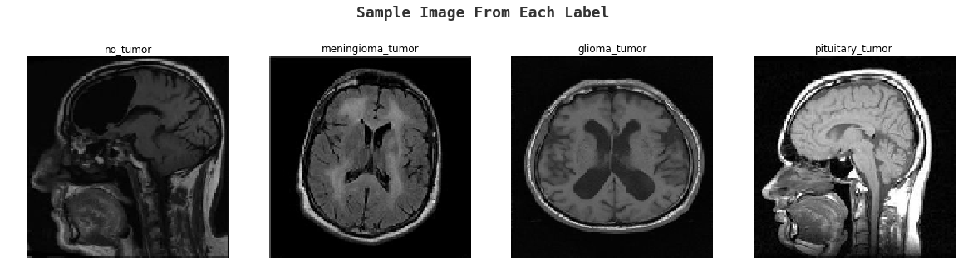
Dataset Summary

Slide 6
Implementation Flow
✅ Dataset Collection
✅ Dataset Loading
✅ Dataset preprocessing
✅ Classifier Defining
✅ Training
✅ Evaluation
✅ Realtime Testing

Slide 7
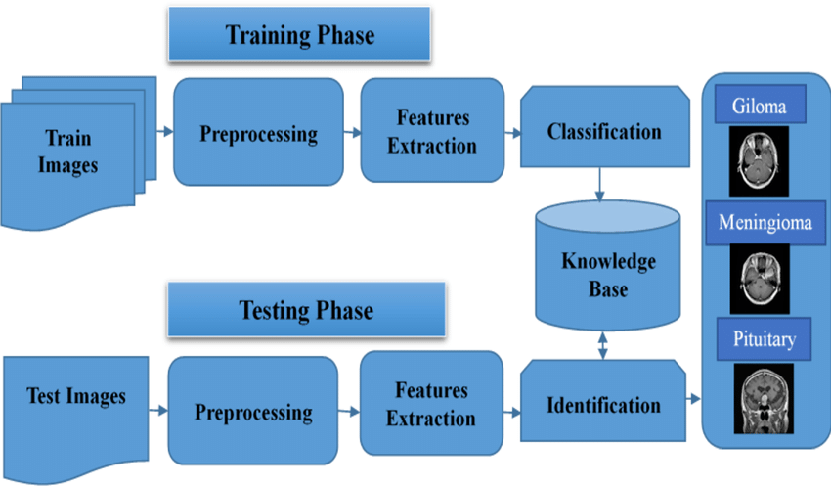
Methodology

Slide 8
Methodology
This work employs machine learning algorithm to classify the brain tumour.
The process starts with the preprocessing of the MRI images which are enhanced using contrast stretching technique.
Data augmentation techniques like rotation and flipping are applied to generate the large amount of data to reduce overfitting.
In the next step, these images will be sent to classifier to train.
The trained model is evaluated using the test data to understand the accuracy of the model.

Slide 9
Logistic Regression
Logistic Regression is a statistical model used for binary classification problems.
It is a linear model that predicts the probability of an output variable based on input features.
The output of the model is a binary outcome, which can be interpreted as a probability of occurrence of an event.
In the context of brain tumor classification, logistic regression can be used to predict whether a patient has a tumor or not.
The algorithm works by fitting a logistic curve to the data and using maximum likelihood estimation to estimate the parameters of the model.

Slide 10
Random Forest
Random Forest is an ensemble learning algorithm used for classification and regression problems.
It works by building multiple decision trees and combining their results to make a final prediction.
Each decision tree is trained on a random subset of the input features and a random subset of the training data.
In the context of brain tumor classification, random forest can be used to classify MRI images into multiple classes.
The algorithm works by creating a forest of decision trees and using the majority vote of the trees to make a final prediction.
In the project, random forest was used to classify the MRI images into four classes - 'no_tumor', 'meningioma_tumor', 'glioma_tumor', and 'pituitary_tumor'.

Slide 11
AdaBoost
AdaBoost is an ensemble learning algorithm used for classification problems.
It works by combining multiple weak classifiers to create a strong classifier.
Each weak classifier is trained on a subset of the input features and a subset of the training data.
In the context of brain tumor classification, AdaBoost can be used to classify MRI images into multiple classes.
The algorithm works by creating a sequence of weak classifiers and assigning higher weights to misclassified samples.
In the project, AdaBoost was used to classify the MRI images into four classes - 'no_tumor', 'meningioma_tumor', 'glioma_tumor', and 'pituitary_tumor'.

Slide 12
KNN Classifier
KNN (K-Nearest Neighbors) is a non-parametric classification algorithm used for classification problems.
It works by finding the K-nearest data points in the training set to a new data point and classifying the new data point based on the majority class of its K-nearest neighbors.
In the context of brain tumor classification, KNN can be used to classify MRI images into multiple classes.
The algorithm works by calculating the Euclidean distance between the new data point and each data point in the training set and selecting the K-nearest neighbors.
In the project, KNN was used to classify the MRI images into four classes - 'no_tumor', 'meningioma_tumor', 'glioma_tumor', and 'pituitary_tumor'.

Slide 13
Validation method
We are validating the performance of the model using Classification report.
The classification report visualizer displays the precision, recall, F1, and support scores for the model.
Precision is the ability of a classifier not to label an instance positive that is actually negative.
For each class, it is defined as the ratio of true positives to the sum of a true positive and false positive.
Recall is the ability of a classifier to find all positive instances.
For each class it is defined as the ratio of true positives to the sum of true positives and false negatives.
The F1 score is a weighted harmonic mean of precision and recall such that the best score is 1.0 and the worst is 0.0.
F1 scores are lower than accuracy measures as they embed precision and recall into their computation.

Slide 14
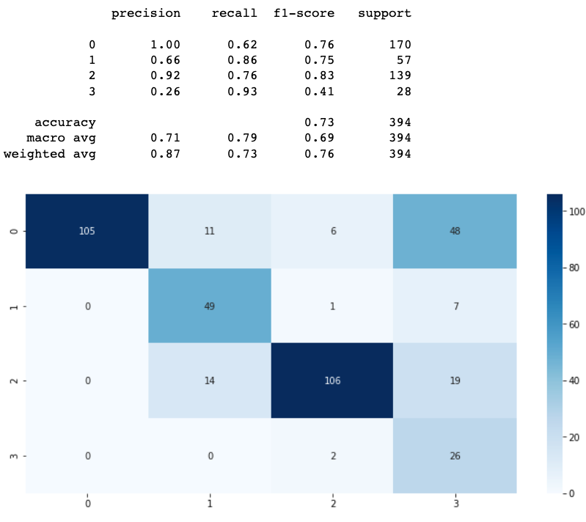
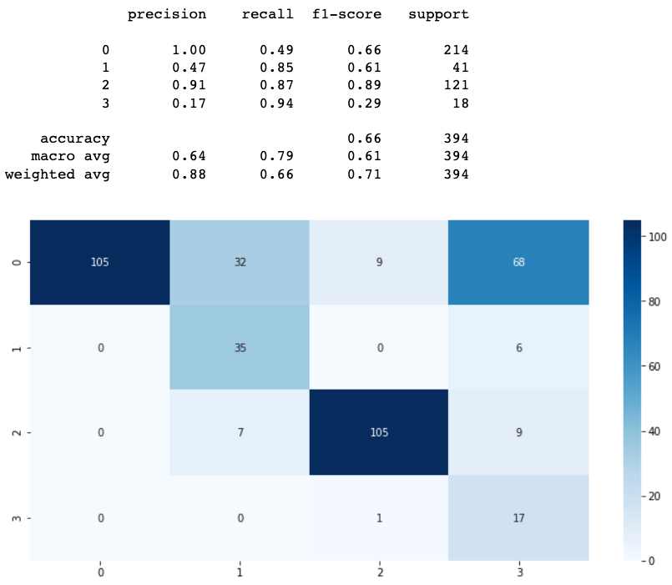
Results
Logistic Regression & Random Forest

Slide 15
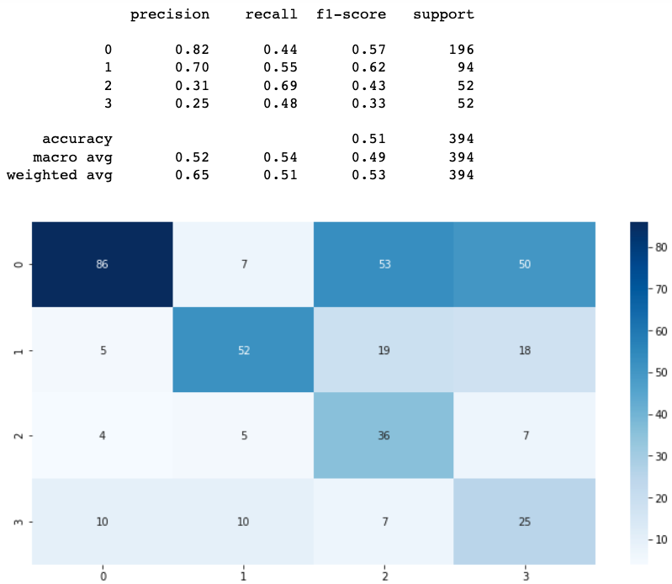
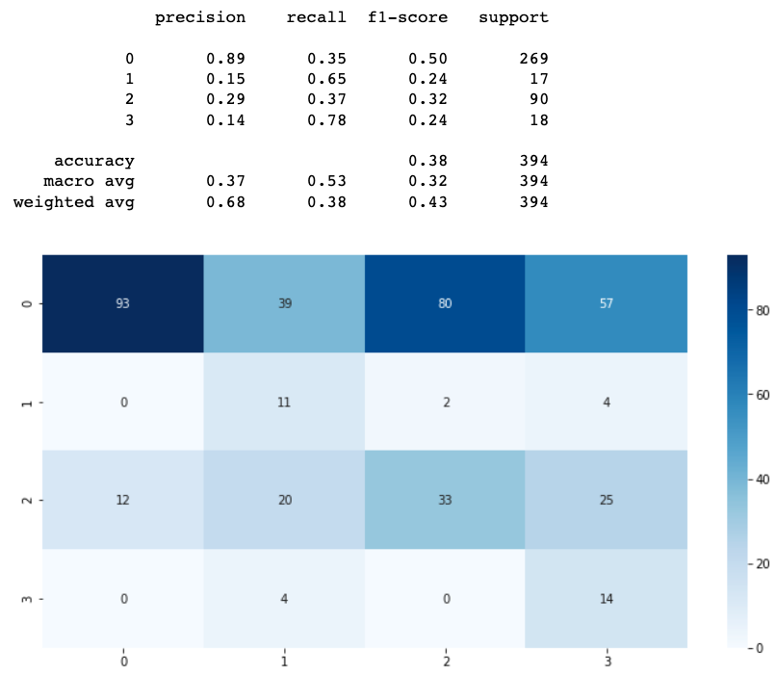
Results
AdaBoost & KNN Classifiers

Slide 16
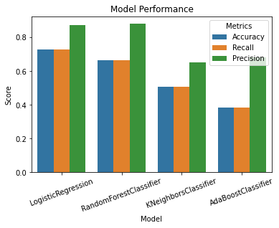
Results

Slide 17
Conclusion & Future Work
the application of machine learning techniques for brain tumor classification has been demonstrated in this project.
Four different algorithms, namely Logistic Regression, Random Forest, AdaBoost, and KNN Classifier were used, and the performance of each algorithm was evaluated using accuracy, recall, and precision metrics.
Among the algorithms, Logistic Regression and Random Forest performed relatively better than the other two, with accuracy scores of 0.725 and 0.664, respectively.
The results indicate the potential of machine learning in the classification of brain tumors using MRI images.
However, the results are not yet sufficient for clinical use, as the accuracy is not high enough for reliable diagnosis.
More research and improvement are needed to develop more accurate models.
One possible approach for future work is to apply deep learning techniques, such as convolutional neural networks (CNNs), to improve the performance of the models.
CNNs have demonstrated great success in image classification tasks and may provide more accurate results for brain tumor classification.

